Slide 1



Class 8: Machine Learning – Decision Trees
UNIT III: Advanced Analytics and Machine Learning Models
Sebastián Muñoz-Herrera, PhD.
Héctor Hormazábal
Muñoz-Herrera and Hormazábal Class 8: Machine Learning – Decision Tree UNIT III: Advanced Analytics and Machine Learning Models

Slide 2
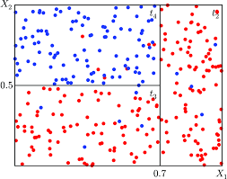
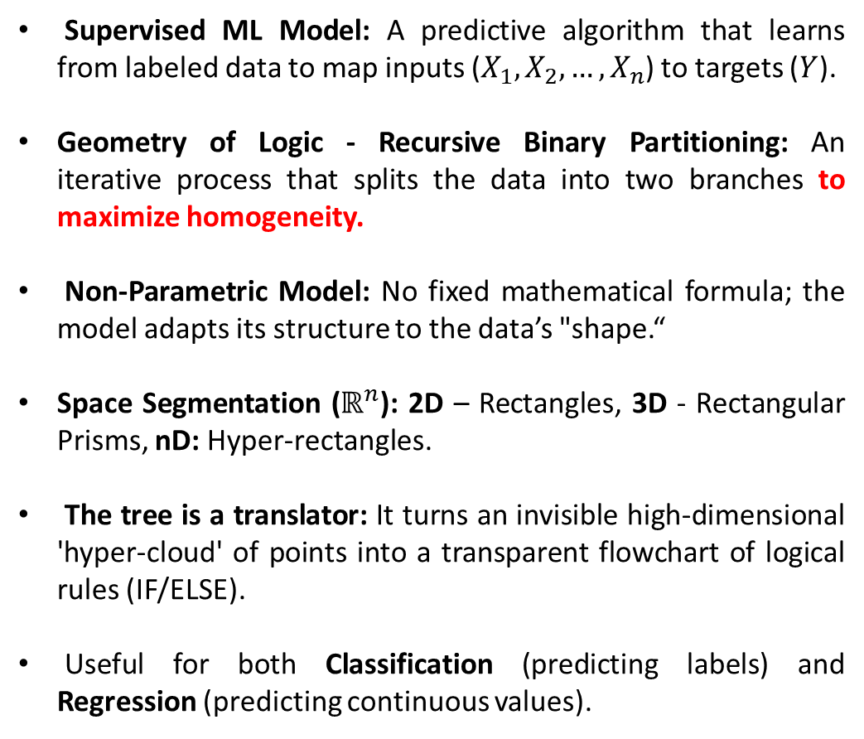
What is a Decision Tree in ML?
Supervised ML Model: A predictive algorithm that learns from labeled data to map inputs ($X_{1},X_{2},…,X_{n}$) to targets ($Y$).
Geometry of Logic - Recursive Binary Partitioning: An iterative process that splits the data into two branches to maximize homogeneity.
Non-Parametric Model: No fixed mathematical formula; the model adapts its structure to the data’s "shape.“
Space Segmentation ($ℝ^{n}$​): 2D – Rectangles, 3D - Rectangular Prisms, nD: Hyper-rectangles.
The tree is a translator: It turns an invisible high-dimensional 'hyper-cloud' of points into a transparent flowchart of logical rules (IF/ELSE).
Useful for both Classification (predicting labels) and Regression (predicting continuous values).
Muñoz-Herrera and Hormazábal Class 8: Machine Learning – Decision Tree UNIT III: Advanced Analytics and Machine Learning Models
Notes:
Let me walk you through the four units of the course so you know exactly where we're headed.
Unit I, which starts today, covers the Fundamentals of Business Intelligence — what it is, how it works, where data comes from.
Unit II moves into Data Preparation and Predictive Models — this is where you'll get your hands dirty cleaning and modeling data.
Unit III is the exciting one: Advanced Analytics and Machine Learning.
And Unit IV brings it all together with a focus on communicating insights ethically to support decision-making.
Notice how the course is structured like a pipeline: first you understand BI, then you prepare data, then you build models, and finally you communicate results. Each unit builds on the previous one — so keeping up with the pace really matters.
If at any point you feel lost, reach out early. We'd rather help you now than rescue you at the final exam.

Slide 3
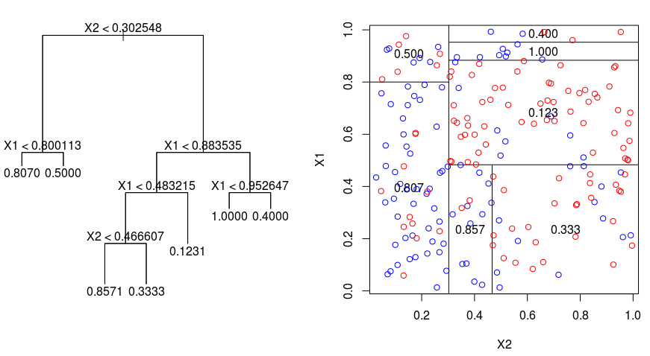
What is a Decision Tree in ML ? Regression Problem
Muñoz-Herrera and Hormazábal Class 8: Machine Learning – Decision Tree UNIT III: Advanced Analytics and Machine Learning Models
Notes:
Let me walk you through the four units of the course so you know exactly where we're headed.
Unit I, which starts today, covers the Fundamentals of Business Intelligence — what it is, how it works, where data comes from.
Unit II moves into Data Preparation and Predictive Models — this is where you'll get your hands dirty cleaning and modeling data.
Unit III is the exciting one: Advanced Analytics and Machine Learning.
And Unit IV brings it all together with a focus on communicating insights ethically to support decision-making.
Notice how the course is structured like a pipeline: first you understand BI, then you prepare data, then you build models, and finally you communicate results. Each unit builds on the previous one — so keeping up with the pace really matters.
If at any point you feel lost, reach out early. We'd rather help you now than rescue you at the final exam.

Slide 4
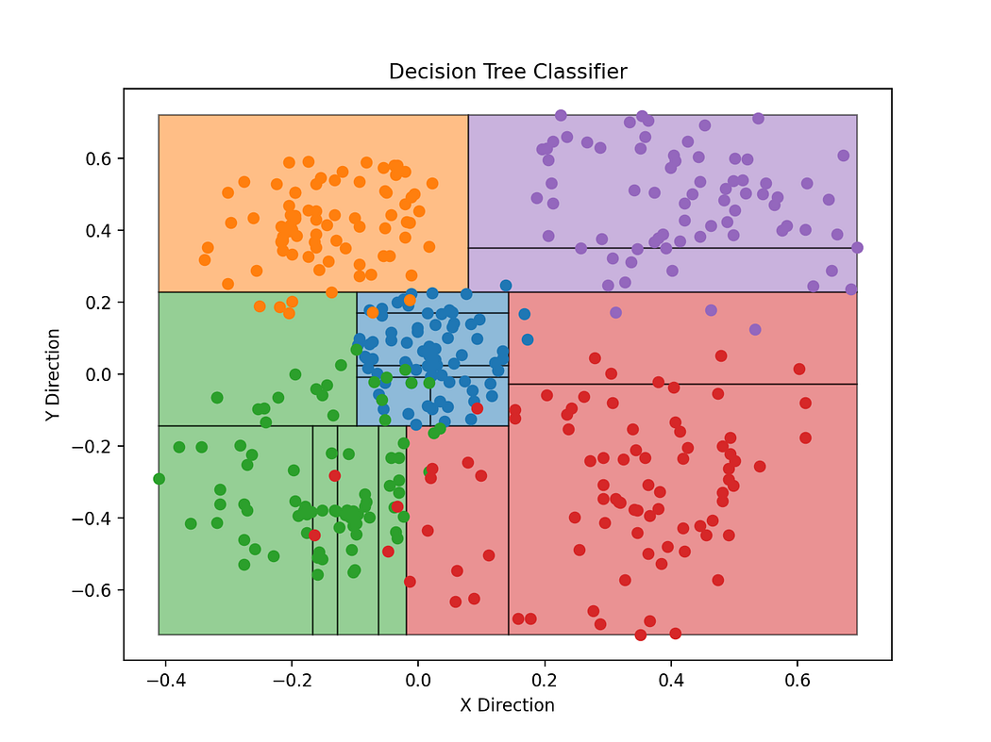
What is a Decision Tree in ML? Classification Problem
Muñoz-Herrera and Hormazábal Class 8: Machine Learning – Decision Tree UNIT III: Advanced Analytics and Machine Learning Models
Notes:
Let me walk you through the four units of the course so you know exactly where we're headed.
Unit I, which starts today, covers the Fundamentals of Business Intelligence — what it is, how it works, where data comes from.
Unit II moves into Data Preparation and Predictive Models — this is where you'll get your hands dirty cleaning and modeling data.
Unit III is the exciting one: Advanced Analytics and Machine Learning.
And Unit IV brings it all together with a focus on communicating insights ethically to support decision-making.
Notice how the course is structured like a pipeline: first you understand BI, then you prepare data, then you build models, and finally you communicate results. Each unit builds on the previous one — so keeping up with the pace really matters.
If at any point you feel lost, reach out early. We'd rather help you now than rescue you at the final exam.

Slide 5
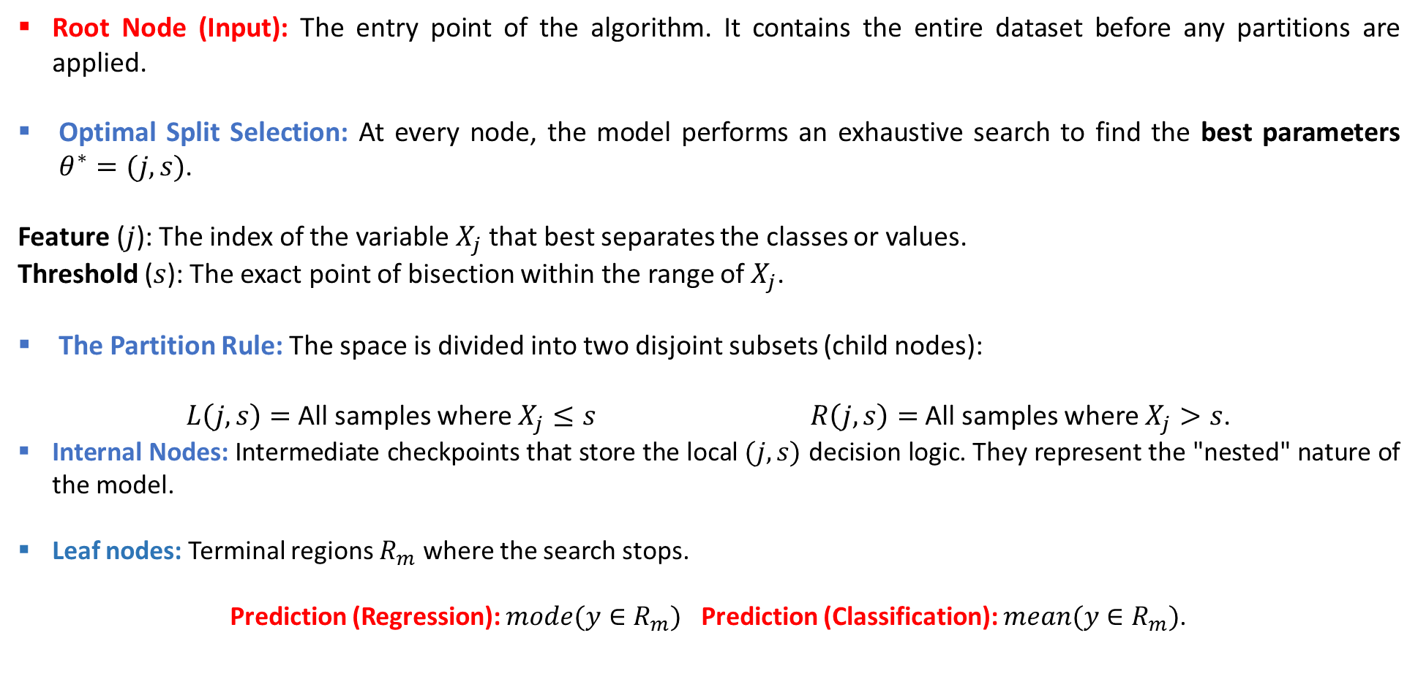
Main algorithm structure - Tree Anatomy
Root Node (Input): The entry point of the algorithm. It contains the entire dataset before any partitions are applied.
Optimal Split Selection: At every node, the model performs an exhaustive search to find the best parameters $θ^{∗}=(j,s)$.
Feature ($j$): The index of the variable $X_{j}$​ that best separates the classes or values.
Threshold ($s$): The exact point of bisection within the range of $X_{j}$.
The Partition Rule: The space is divided into two disjoint subsets (child nodes):
$L\left(j,s\right)=$All samples where $X_{j}≤s$ $R\left(j,s\right)=$All samples where $X_{j}>s$.
Internal Nodes: Intermediate checkpoints that store the local $(j,s)$ decision logic. They represent the "nested" nature of the model.
Leaf nodes: Terminal regions $R_{m}$ where the search stops.
Prediction (Regression): $mode(y∈R_{m})$ Prediction (Classification): $mean(y∈R_{m})$.
Muñoz-Herrera and Hormazábal Class 8: Machine Learning – Decision Tree UNIT III: Advanced Analytics and Machine Learning Models
Notes:
Let me walk you through the four units of the course so you know exactly where we're headed.
Unit I, which starts today, covers the Fundamentals of Business Intelligence — what it is, how it works, where data comes from.
Unit II moves into Data Preparation and Predictive Models — this is where you'll get your hands dirty cleaning and modeling data.
Unit III is the exciting one: Advanced Analytics and Machine Learning.
And Unit IV brings it all together with a focus on communicating insights ethically to support decision-making.
Notice how the course is structured like a pipeline: first you understand BI, then you prepare data, then you build models, and finally you communicate results. Each unit builds on the previous one — so keeping up with the pace really matters.
If at any point you feel lost, reach out early. We'd rather help you now than rescue you at the final exam.

Slide 6
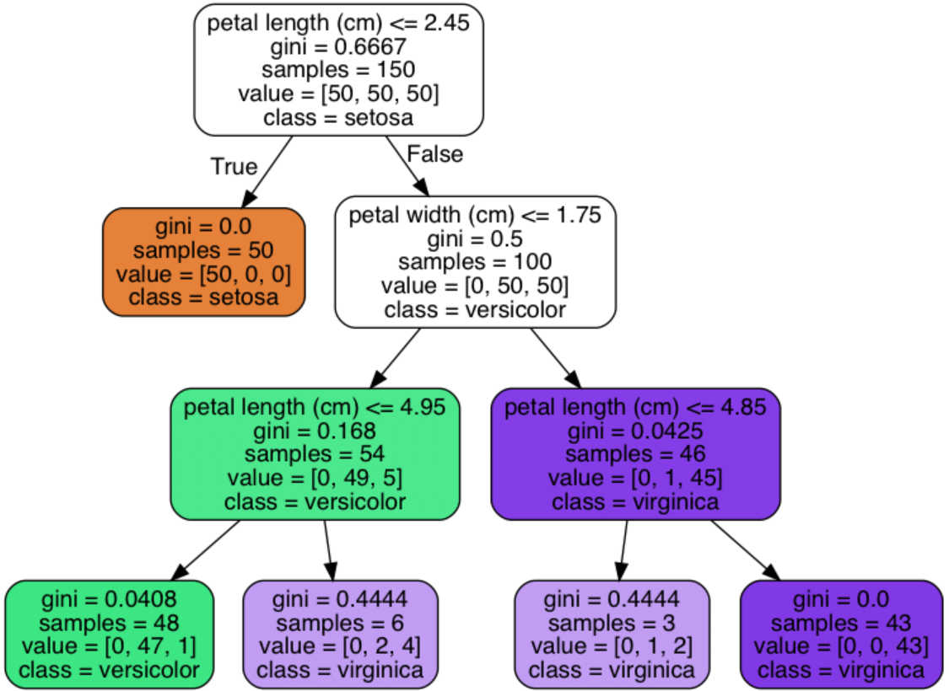
Main algorithm structure - Tree Anatomy
Muñoz-Herrera and Hormazábal Class 8: Machine Learning – Decision Tree UNIT III: Advanced Analytics and Machine Learning Models
Notes:
Let me walk you through the four units of the course so you know exactly where we're headed.
Unit I, which starts today, covers the Fundamentals of Business Intelligence — what it is, how it works, where data comes from.
Unit II moves into Data Preparation and Predictive Models — this is where you'll get your hands dirty cleaning and modeling data.
Unit III is the exciting one: Advanced Analytics and Machine Learning.
And Unit IV brings it all together with a focus on communicating insights ethically to support decision-making.
Notice how the course is structured like a pipeline: first you understand BI, then you prepare data, then you build models, and finally you communicate results. Each unit builds on the previous one — so keeping up with the pace really matters.
If at any point you feel lost, reach out early. We'd rather help you now than rescue you at the final exam.

Slide 7
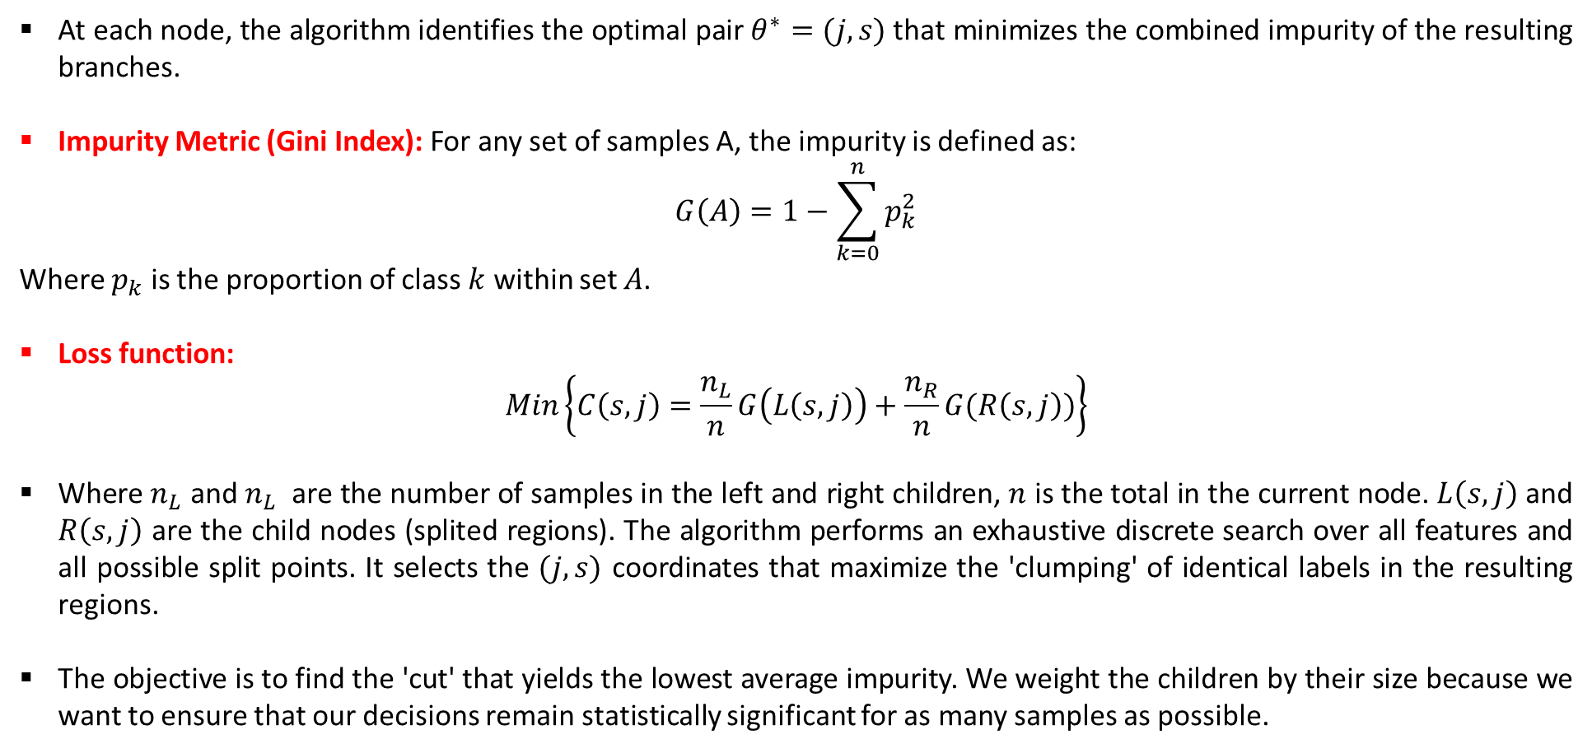
Optimization in Classification – Slicing process
At each node, the algorithm identifies the optimal pair $θ^{∗}=(j,s)$that minimizes the combined impurity of the resulting branches.
Impurity Metric (Gini Index): For any set of samples A, the impurity is defined as:
$$G\left(A\right)=1−\sum_{k=0}^{n}{p_{k}^{2}}$$
Where $p_{k}$ is the proportion of class $k$ within set $A$.
Loss function:
$$Min\left\{C\left(s,j\right)=\frac{n_{L}}{n}G\left(L\left(s,j\right)\right)+\frac{n_{R}}{n}G(R\left(s,j\right))\right\}$$
Where $n_{L}$​ and $n_{L}$​ are the number of samples in the left and right children, $n$ is the total in the current node. $L\left(s,j\right)$ and $R\left(s,j\right)$ are the child nodes (splited regions). The algorithm performs an exhaustive discrete search over all features and all possible split points. It selects the $(j,s)$ coordinates that maximize the 'clumping' of identical labels in the resulting regions.
The objective is to find the 'cut' that yields the lowest average impurity. We weight the children by their size because we want to ensure that our decisions remain statistically significant for as many samples as possible.
Muñoz-Herrera and Hormazábal Class 8: Machine Learning – Decision Tree UNIT III: Advanced Analytics and Machine Learning Models
Notes:
Let me walk you through the four units of the course so you know exactly where we're headed.
Unit I, which starts today, covers the Fundamentals of Business Intelligence — what it is, how it works, where data comes from.
Unit II moves into Data Preparation and Predictive Models — this is where you'll get your hands dirty cleaning and modeling data.
Unit III is the exciting one: Advanced Analytics and Machine Learning.
And Unit IV brings it all together with a focus on communicating insights ethically to support decision-making.
Notice how the course is structured like a pipeline: first you understand BI, then you prepare data, then you build models, and finally you communicate results. Each unit builds on the previous one — so keeping up with the pace really matters.
If at any point you feel lost, reach out early. We'd rather help you now than rescue you at the final exam.

Slide 8
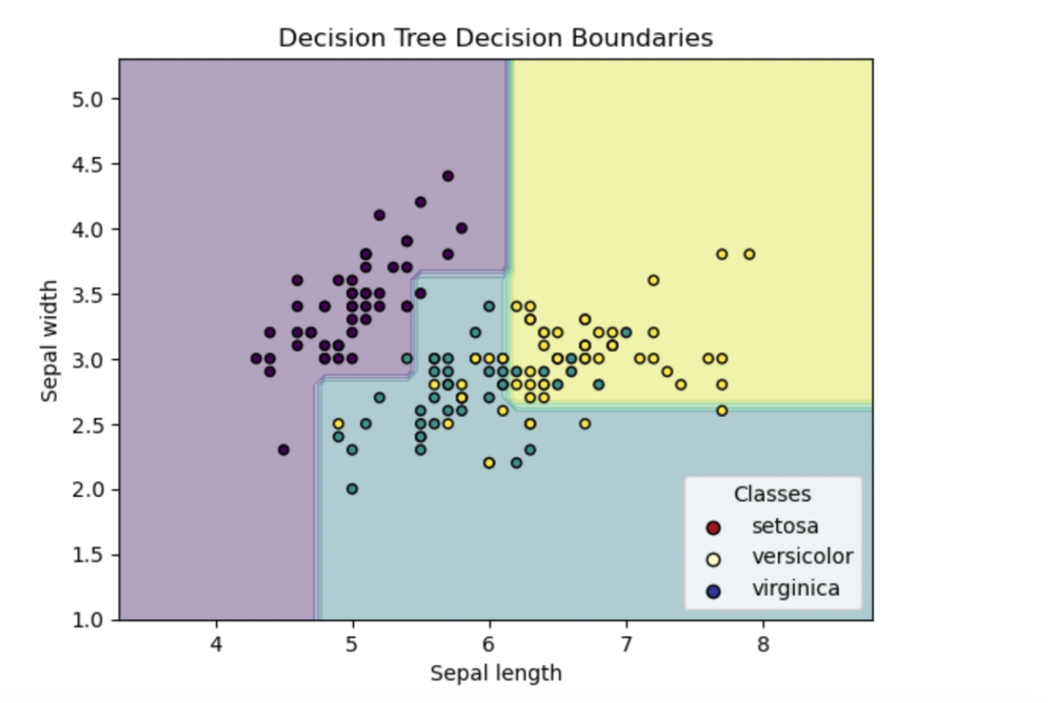
Optimization in Classification – Slicing process
Muñoz-Herrera and Hormazábal Class 8: Machine Learning – Decision Tree UNIT III: Advanced Analytics and Machine Learning Models
Notes:
Let me walk you through the four units of the course so you know exactly where we're headed.
Unit I, which starts today, covers the Fundamentals of Business Intelligence — what it is, how it works, where data comes from.
Unit II moves into Data Preparation and Predictive Models — this is where you'll get your hands dirty cleaning and modeling data.
Unit III is the exciting one: Advanced Analytics and Machine Learning.
And Unit IV brings it all together with a focus on communicating insights ethically to support decision-making.
Notice how the course is structured like a pipeline: first you understand BI, then you prepare data, then you build models, and finally you communicate results. Each unit builds on the previous one — so keeping up with the pace really matters.
If at any point you feel lost, reach out early. We'd rather help you now than rescue you at the final exam.

Slide 9
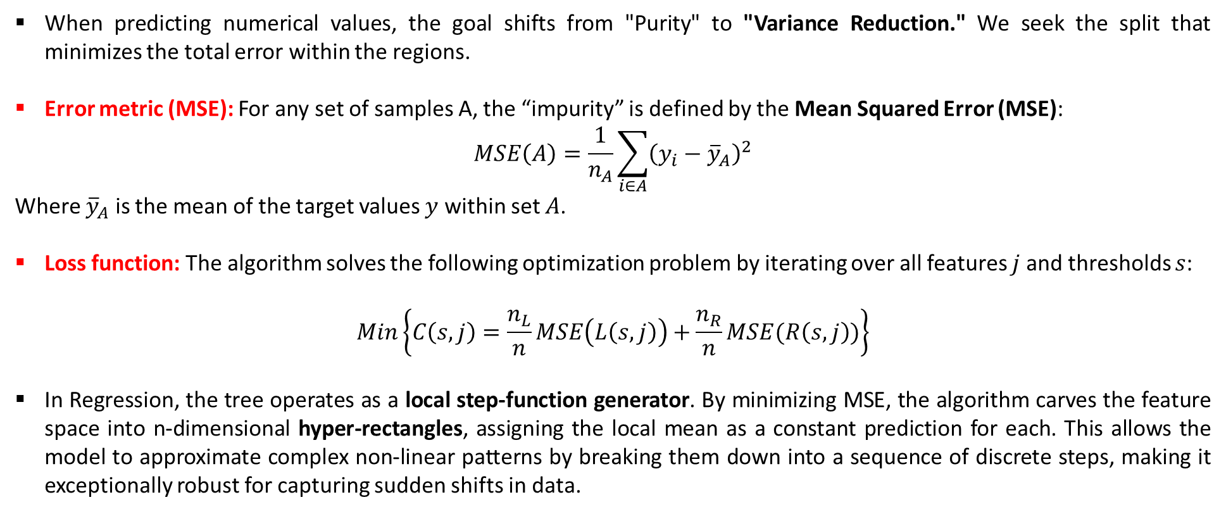
Optimization in Regression – Slicing process
When predicting numerical values, the goal shifts from "Purity" to "Variance Reduction." We seek the split that minimizes the total error within the regions.
Error metric (MSE): For any set of samples A, the “impurity” is defined by the Mean Squared Error (MSE):
$$MSE\left(A\right)=\frac{1}{n_{A}}\sum_{i∈A}{{\left(y_{i}−{\overline{y}}_{A}\right)}^{2}}$$
Where ${\overline{y}}_{A}​$ is the mean of the target values $y$ within set $A$.
Loss function: The algorithm solves the following optimization problem by iterating over all features $j$ and thresholds $s$:
$$Min\left\{C\left(s,j\right)=\frac{n_{L}}{n}MSE\left(L\left(s,j\right)\right)+\frac{n_{R}}{n}MSE(R\left(s,j\right))\right\}$$
In Regression, the tree operates as a local step-function generator. By minimizing MSE, the algorithm carves the feature space into n-dimensional hyper-rectangles, assigning the local mean as a constant prediction for each. This allows the model to approximate complex non-linear patterns by breaking them down into a sequence of discrete steps, making it exceptionally robust for capturing sudden shifts in data.
Muñoz-Herrera and Hormazábal Class 8: Machine Learning – Decision Tree UNIT III: Advanced Analytics and Machine Learning Models
Notes:
Let me walk you through the four units of the course so you know exactly where we're headed.
Unit I, which starts today, covers the Fundamentals of Business Intelligence — what it is, how it works, where data comes from.
Unit II moves into Data Preparation and Predictive Models — this is where you'll get your hands dirty cleaning and modeling data.
Unit III is the exciting one: Advanced Analytics and Machine Learning.
And Unit IV brings it all together with a focus on communicating insights ethically to support decision-making.
Notice how the course is structured like a pipeline: first you understand BI, then you prepare data, then you build models, and finally you communicate results. Each unit builds on the previous one — so keeping up with the pace really matters.
If at any point you feel lost, reach out early. We'd rather help you now than rescue you at the final exam.

Slide 10
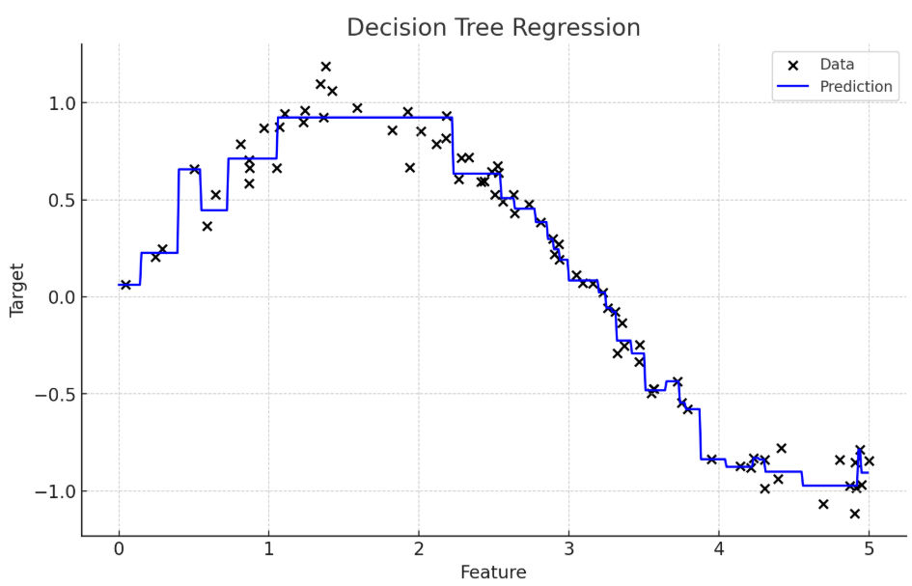
Optimization in Regression – Slicing process
Muñoz-Herrera and Hormazábal Class 8: Machine Learning – Decision Tree UNIT III: Advanced Analytics and Machine Learning Models
Notes:
Let me walk you through the four units of the course so you know exactly where we're headed.
Unit I, which starts today, covers the Fundamentals of Business Intelligence — what it is, how it works, where data comes from.
Unit II moves into Data Preparation and Predictive Models — this is where you'll get your hands dirty cleaning and modeling data.
Unit III is the exciting one: Advanced Analytics and Machine Learning.
And Unit IV brings it all together with a focus on communicating insights ethically to support decision-making.
Notice how the course is structured like a pipeline: first you understand BI, then you prepare data, then you build models, and finally you communicate results. Each unit builds on the previous one — so keeping up with the pace really matters.
If at any point you feel lost, reach out early. We'd rather help you now than rescue you at the final exam.

Slide 11
Alternative Impurity Criteria
The Classification And Regression Trees (CART) Framework & Information Gain:
Metric | Domain | Logic for the Model
Gini Impurity | Classification | Measures the probability of a random element being misclassified. Faster (no logs).
Entropy | Classification | Measures the "Information Bits" (uncertainty). Strict; penalizes mixed nodes more aggressively.
Information Gain | Classification | The delta or "profit" in information. The algorithm selects the split that maximizes this gain.
MSE / Variance | Regression | Measures the "spread" of continuous values. The goal is to minimize internal variance within the leaf.
Muñoz-Herrera and Hormazábal Class 8: Machine Learning – Decision Tree UNIT III: Advanced Analytics and Machine Learning Models
Notes:
Let me walk you through the four units of the course so you know exactly where we're headed.
Unit I, which starts today, covers the Fundamentals of Business Intelligence — what it is, how it works, where data comes from.
Unit II moves into Data Preparation and Predictive Models — this is where you'll get your hands dirty cleaning and modeling data.
Unit III is the exciting one: Advanced Analytics and Machine Learning.
And Unit IV brings it all together with a focus on communicating insights ethically to support decision-making.
Notice how the course is structured like a pipeline: first you understand BI, then you prepare data, then you build models, and finally you communicate results. Each unit builds on the previous one — so keeping up with the pace really matters.
If at any point you feel lost, reach out early. We'd rather help you now than rescue you at the final exam.

Slide 12
Stopping Criteria & Hyperparameters
A tree with no constraints will grow until every leaf is pure (G=0), leading to overfitting. We use hyperparameters to restrict growth and improve generalization.
Hyperparameter | Functional Objective | Operational Impact | Typical Range
max_depth | Limits tree height | Constrains feature interaction depth. | [3,20]
min_samples_split | Pre-split requirement | Prevents splitting small, noisy clusters. | [2,50]
min_samples_leaf | Minimum leaf size | Smooths predictions; reduces variance. | [1,20]
max_leaf_nodes | Caps total complexity | Limits the number of "step-functions." | [10,100+]
criterion | Selects impurity metric | Switches between Gini or Entropy/MSE. | gini, entropy
Muñoz-Herrera and Hormazábal Class 8: Machine Learning – Decision Tree UNIT III: Advanced Analytics and Machine Learning Models
Notes:
Let me walk you through the four units of the course so you know exactly where we're headed.
Unit I, which starts today, covers the Fundamentals of Business Intelligence — what it is, how it works, where data comes from.
Unit II moves into Data Preparation and Predictive Models — this is where you'll get your hands dirty cleaning and modeling data.
Unit III is the exciting one: Advanced Analytics and Machine Learning.
And Unit IV brings it all together with a focus on communicating insights ethically to support decision-making.
Notice how the course is structured like a pipeline: first you understand BI, then you prepare data, then you build models, and finally you communicate results. Each unit builds on the previous one — so keeping up with the pace really matters.
If at any point you feel lost, reach out early. We'd rather help you now than rescue you at the final exam.

Slide 13
Practical Trade-offs
Decision Trees are "White Box" models, offering high interpretability but facing specific structural limitations that every Data Scientist must manage.
Decision trees are inherently unstable and prone to high variance, meaning minor data fluctuations can lead to completely different splits and poor generalization.
Aspect | Advantage | Constraint
Model Nature | White-Box: Decisions are traceable and human-readable. | High Variance: Highly sensitive to small training set fluctuations.
Data Topology | Non-Linear: Captures complex feature interactions natively. | Orthogonal Splits: Can only cut the space in axis-aligned steps.
Preprocessing | Zero-Effort: No scaling, centering, or normalization required. | Greedy Heuristic: Local optima at each node; no global optimization.
Utility | Feature Rank: Automates identification of key drivers. | Overfitting: Naturally tends to memorize noise/outliers.
Muñoz-Herrera and Hormazábal Class 8: Machine Learning – Decision Tree UNIT III: Advanced Analytics and Machine Learning Models
Notes:
Let me walk you through the four units of the course so you know exactly where we're headed.
Unit I, which starts today, covers the Fundamentals of Business Intelligence — what it is, how it works, where data comes from.
Unit II moves into Data Preparation and Predictive Models — this is where you'll get your hands dirty cleaning and modeling data.
Unit III is the exciting one: Advanced Analytics and Machine Learning.
And Unit IV brings it all together with a focus on communicating insights ethically to support decision-making.
Notice how the course is structured like a pipeline: first you understand BI, then you prepare data, then you build models, and finally you communicate results. Each unit builds on the previous one — so keeping up with the pace really matters.
If at any point you feel lost, reach out early. We'd rather help you now than rescue you at the final exam.

Slide 14
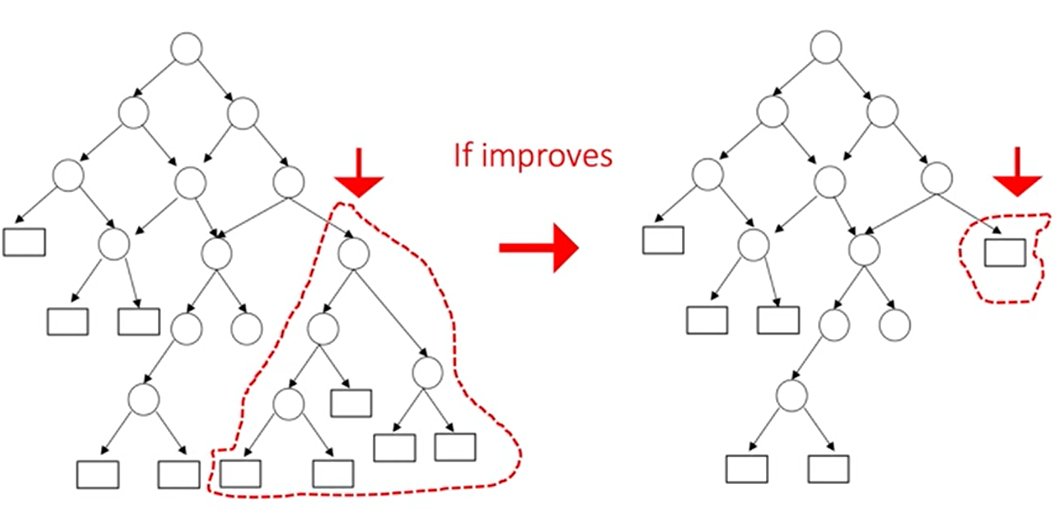
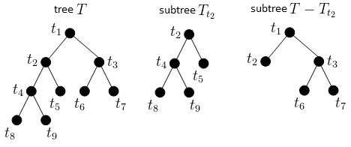
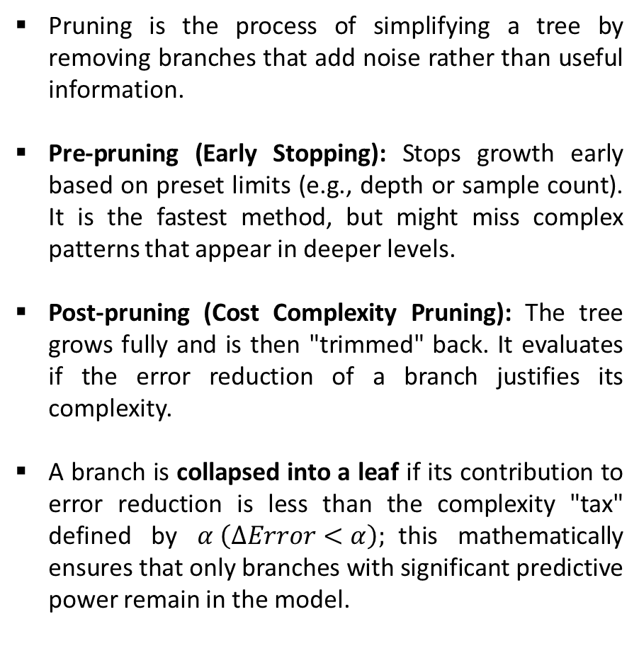
Pruning & Complexity Control
Pruning is the process of simplifying a tree by removing branches that add noise rather than useful information.
Pre-pruning (Early Stopping): Stops growth early based on preset limits (e.g., depth or sample count). It is the fastest method, but might miss complex patterns that appear in deeper levels.
Post-pruning (Cost Complexity Pruning): The tree grows fully and is then "trimmed" back. It evaluates if the error reduction of a branch justifies its complexity.
A branch is collapsed into a leaf if its contribution to error reduction is less than the complexity "tax" defined by $α \left(ΔError<α\right);$this mathematically ensures that only branches with significant predictive power remain in the model.
Muñoz-Herrera and Hormazábal Class 8: Machine Learning – Decision Tree UNIT III: Advanced Analytics and Machine Learning Models
Notes:
Let me walk you through the four units of the course so you know exactly where we're headed.
Unit I, which starts today, covers the Fundamentals of Business Intelligence — what it is, how it works, where data comes from.
Unit II moves into Data Preparation and Predictive Models — this is where you'll get your hands dirty cleaning and modeling data.
Unit III is the exciting one: Advanced Analytics and Machine Learning.
And Unit IV brings it all together with a focus on communicating insights ethically to support decision-making.
Notice how the course is structured like a pipeline: first you understand BI, then you prepare data, then you build models, and finally you communicate results. Each unit builds on the previous one — so keeping up with the pace really matters.
If at any point you feel lost, reach out early. We'd rather help you now than rescue you at the final exam.

Slide 15
Model Interpretability & Business Logic
Translating Non-Functional Models for Stakeholders: Since Decision Trees do not have a functional form (like $y=β0​+β1​x$), we use the following framework to interpret "feature weight" and decision flow:
Tool | Technical Metric | Stakeholder Utility
IF-THEN Rules | Decision Path (Root to Leaf) | Transparency: Provides a clear "audit trail" for every individual prediction.
Feature Importance (MDI) | Mean Decrease in Impurity | Strategy: Identifies which variables drive the most value across the entire business logic.
SHAP Values | Local Feature Contribution | Individualization: Explains exactly why a specific case deviated from the average baseline.
Muñoz-Herrera and Hormazábal Class 8: Machine Learning – Decision Tree UNIT III: Advanced Analytics and Machine Learning Models
Notes:
Let me walk you through the four units of the course so you know exactly where we're headed.
Unit I, which starts today, covers the Fundamentals of Business Intelligence — what it is, how it works, where data comes from.
Unit II moves into Data Preparation and Predictive Models — this is where you'll get your hands dirty cleaning and modeling data.
Unit III is the exciting one: Advanced Analytics and Machine Learning.
And Unit IV brings it all together with a focus on communicating insights ethically to support decision-making.
Notice how the course is structured like a pipeline: first you understand BI, then you prepare data, then you build models, and finally you communicate results. Each unit builds on the previous one — so keeping up with the pace really matters.
If at any point you feel lost, reach out early. We'd rather help you now than rescue you at the final exam.

Slide 16

Practical Section
Google Colab — ML Linear Regression v/s Decision Tree
Simple and Multiple scenarios
No linear relationship between features and target
Performance metrics
Visualization
Muñoz-Herrera and Hormazábal Class 8: Machine Learning – Decision Tree UNIT III: Advanced Analytics and Machine Learning Models

Slide 17
Class 8: Machine Learning – Decision Trees
UNIT III: Advanced Analytics and Machine Learning Models
Sebastián Muñoz-Herrera, PhD.
Héctor Hormazábal
Muñoz-Herrera and Hormazábal Class 8: Machine Learning – Decision Tree UNIT III: Advanced Analytics and Machine Learning Models

